Slide 1

Technical Presentation
SVBRDF Estimation using a Physically-based Differentiable Renderer Markus Andreas Worchel

Slide 2
Recap
Physically-based Differentiable Renderer
Deschaintre et al.,
2018 (single view)
2019 (multi view)

Slide 3
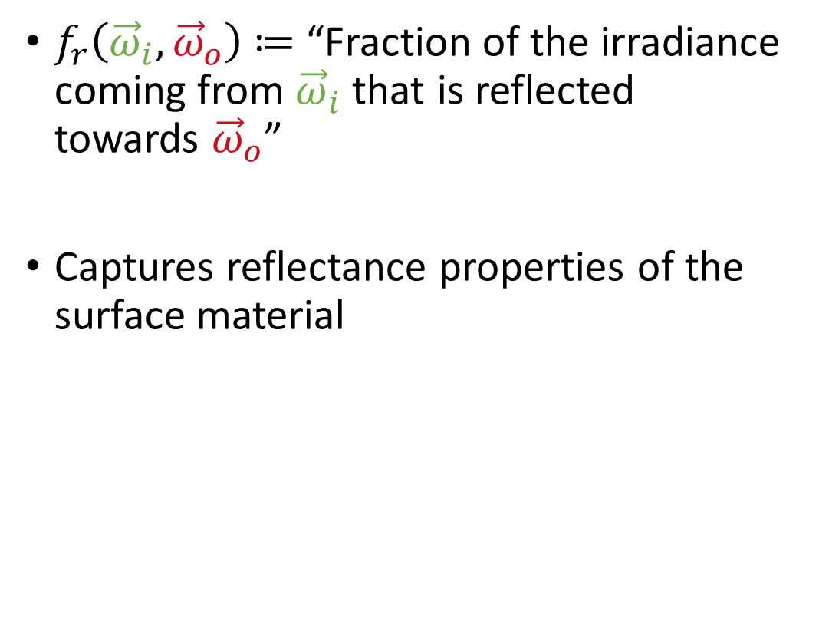

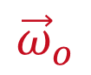

Bidirectional Reflectance Distribution Function
$f_{r}\left({\vec{ω}}_{i},{\vec{ω}}_{o}\right)$ $≔$ “Fraction of the irradiance coming from ${\vec{ω}}_{i}$ that is reflected towards ${\vec{ω}}_{o}$”
Captures reflectance properties of the surface material
$${\vec{ω}}_{i}$$
$$\vec{n}$$
$${\vec{ω}}_{o}$$

Slide 4
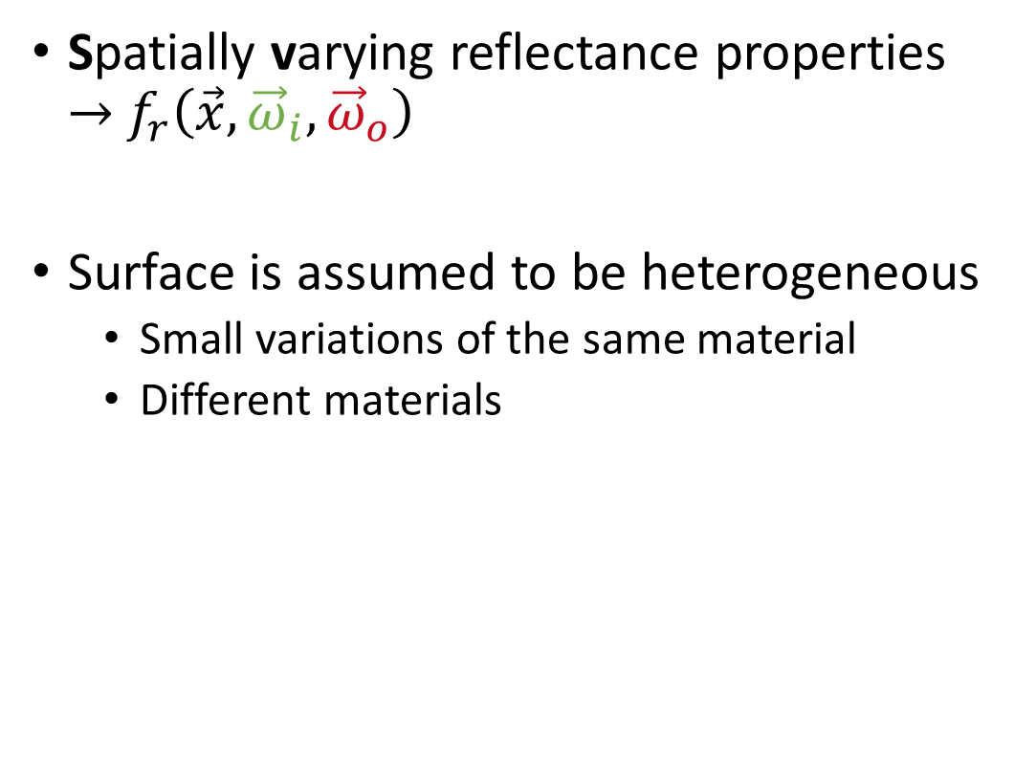
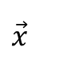

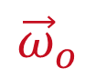

Spatially Varying BRDF
Spatially varying reflectance properties $→$ $f_{r}\left(\vec{x}, {\vec{ω}}_{i},{\vec{ω}}_{o}\right)$
Surface is assumed to be heterogeneous
Small variations of the same material
Different materials
$${\vec{ω}}_{i}$$
$$\vec{n}$$
$${\vec{ω}}_{o}$$
$$\vec{x}$$

Slide 5


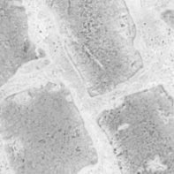
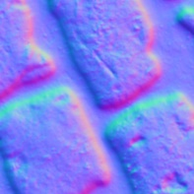
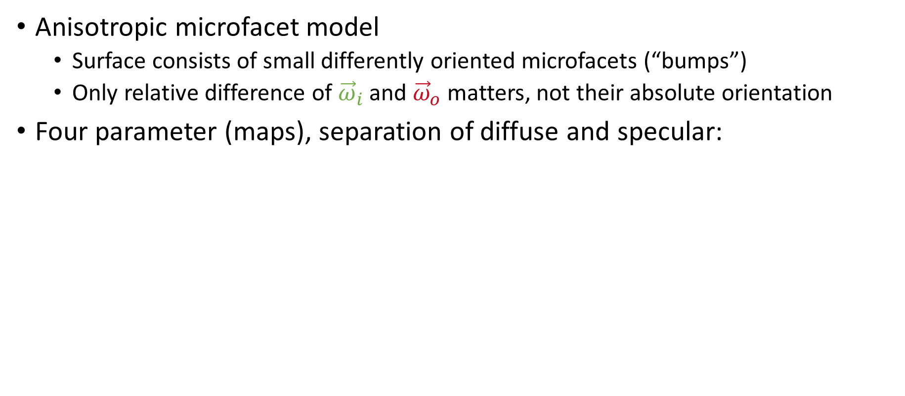
Cook-Torrance BRDF
Anisotropic microfacet model
Surface consists of small differently oriented microfacets (“bumps”)
Only relative difference of ${\vec{ω}}_{i}$ and ${\vec{ω}}_{o}$ matters, not their absolute orientation
Four parameter (maps), separation of diffuse and specular:
Diffuse Albedo
Specular Albedo
Specular Roughness
Normal

Slide 6
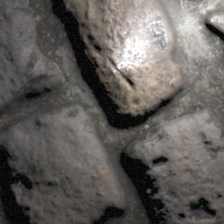
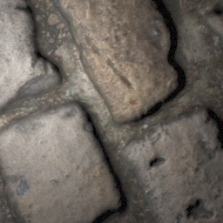
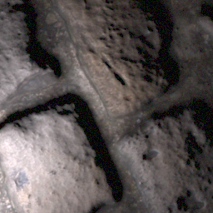
Network Architecture
Fusion
Generator
Diffuse Albedo
Specular Albedo
Generator
Roughness
Generator
Normal
…

Slide 7
Network Architecture – Generator
Based on U-Net architecture for image-to-image transformation
Additional track reinjects global information lost due to instance norm
256x256x3
128x128x64
64x64x128
1x1x512
64x64x (128+128)
128x128x (64+64)
256x256x64
Encoder
Decoder
…
…
…
…
1x1x128
1x1x512
1x1x256
1x1x128
1x1x64

Slide 8
Network Architecture – Multi-View Fusion
nx256x256x64
256x256x64
256x256x9
1
2
…
Max Pooling
3 Convolutions
…
n
1
Max Pooling
2
…
…
n
nx1x1x64
1x1x64

Slide 9
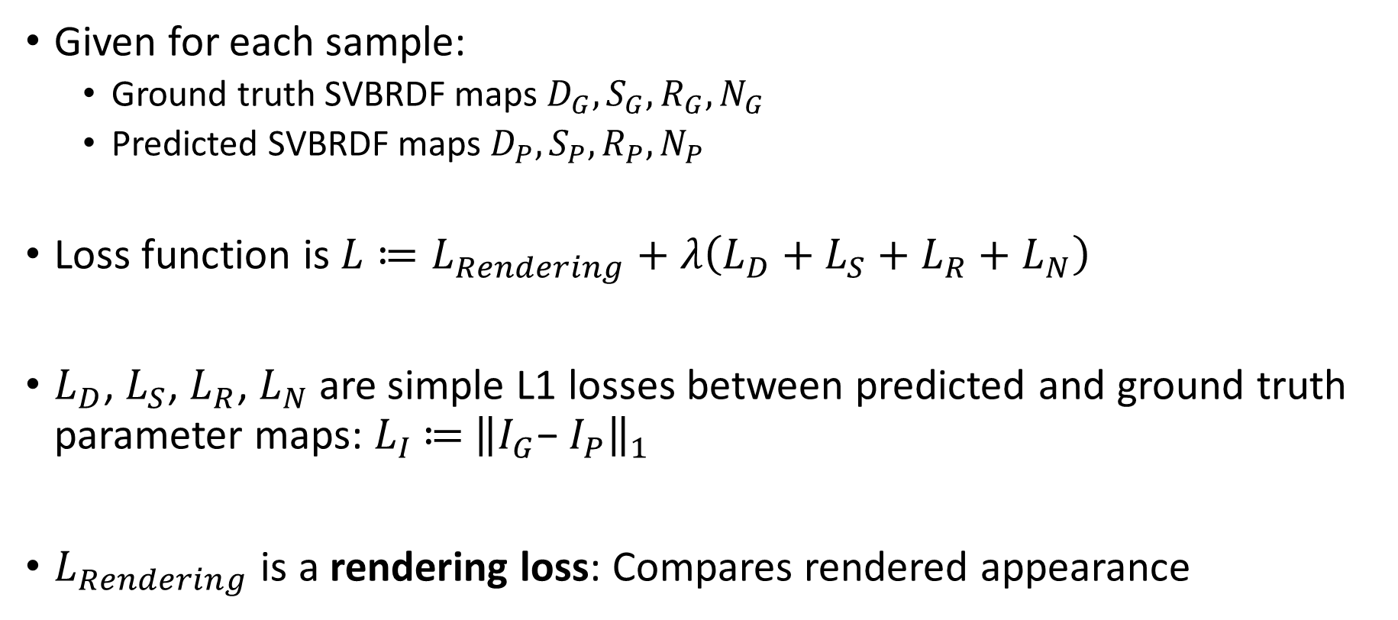
Training – Loss
Given for each sample:
Ground truth SVBRDF maps $D_{G}, S_{G}, R_{G},N_{G}$
Predicted SVBRDF maps $D_{P}, S_{P}, R_{P},N_{P}$
Loss function is $L≔L_{Rendering}+λ\left(L_{D}+L_{S}+L_{R}+L_{N}\right)$
$L_{D}$, $L_{S}$, $L_{R}$, $L_{N}$are simple L1 losses between predicted and ground truth parameter maps: $L_{I}$ $≔$ ${{\left\|I_{G}\text{− }I_{P}\right\|}_{1}}_{}$
$L_{Rendering}$ is a rendering loss: Compares rendered appearance

Slide 10

Training – Rendering Loss
📷
💡
💡
💡
📷
📷
1. Scene definition
2. Light and camera configurations (include specular configurations)
3. Render object with ground truth SVBRDF in all different configurations
-
-
4. Render object with predicted SVBRDF in all different configurations
5. Compare the rendered images (L1 loss)

Slide 11
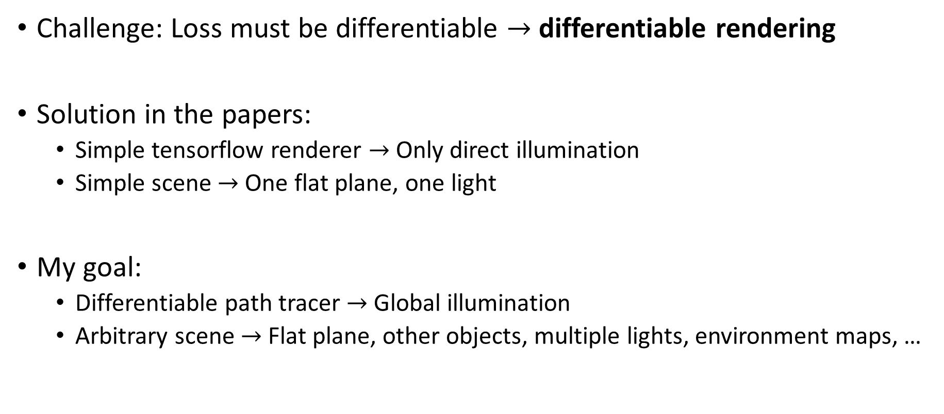
Training – Rendering Loss
Challenge: Loss must be differentiable $→$ differentiable rendering
Solution in the papers:
Simple tensorflow renderer $→$ Only direct illumination
Simple scene $→$ One flat plane, one light
My goal:
Differentiable path tracer $→$ Global illumination
Arbitrary scene $→$ Flat plane, other objects, multiple lights, environment maps, …

Slide 12
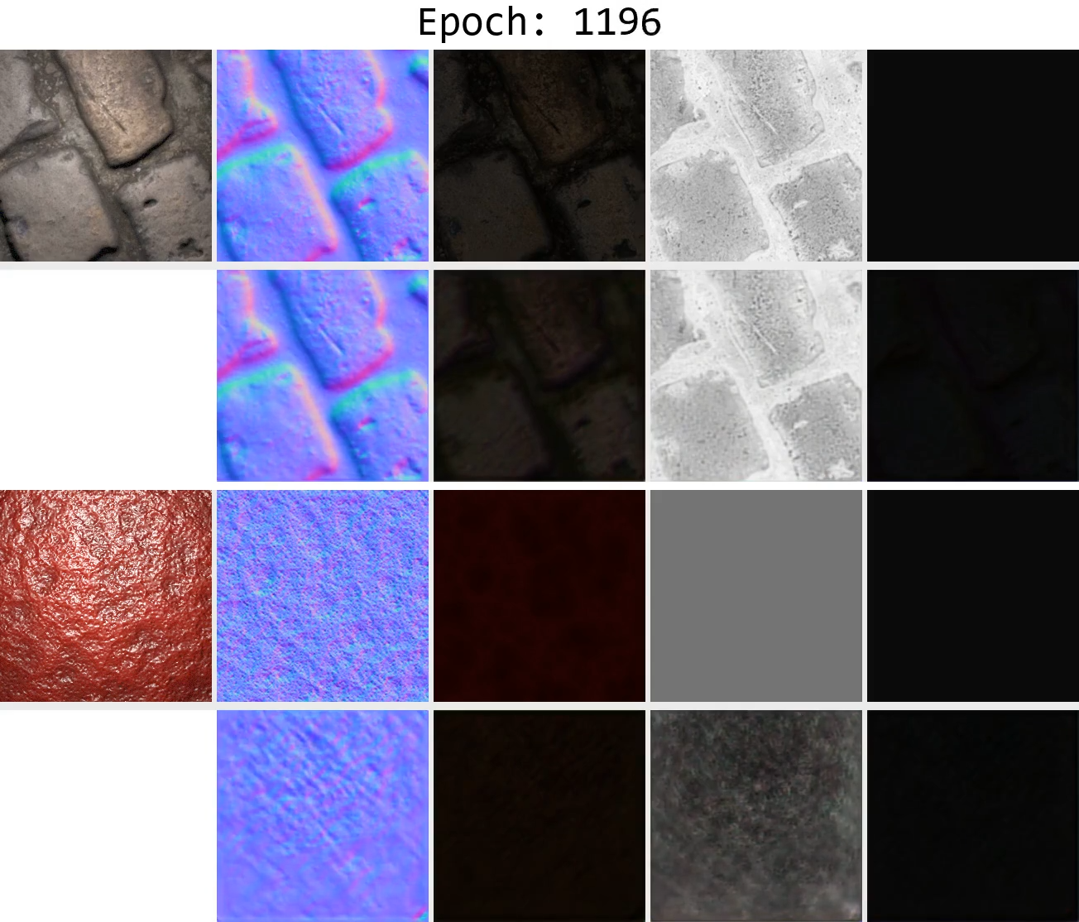
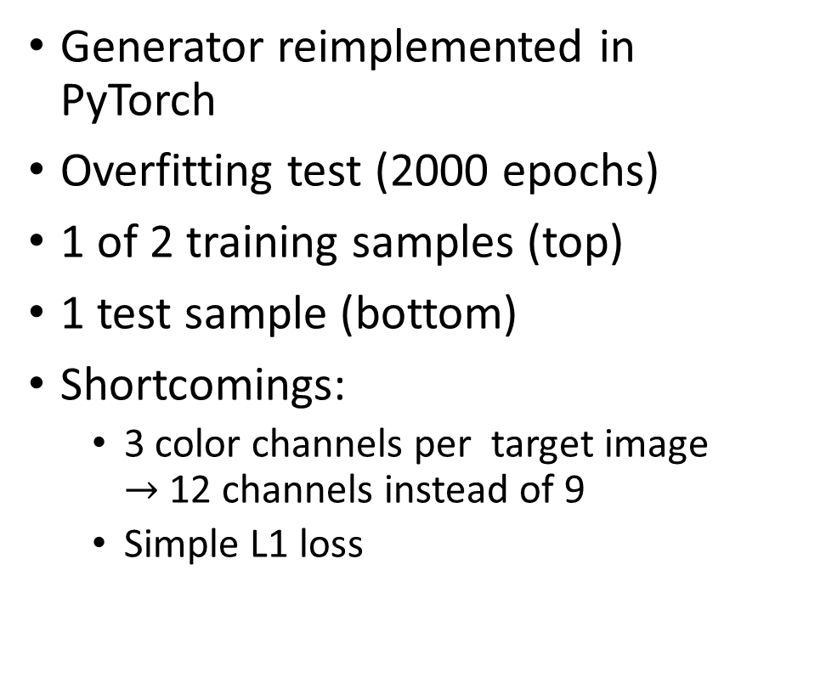
Current State – Generator
Generator reimplemented in PyTorch
Overfitting test (2000 epochs)
1 of 2 training samples (top)
1 test sample (bottom)
Shortcomings:
3 color channels per target image $→$ 12 channels instead of 9
Simple L1 loss

Slide 13
Network Architecture – Generator
Instance norm stabilizes training
Instance norm normalizes each output channel over the whole spatial dimension (width x height) -> subtract mean, divide by standard deviation
Fails to reproduce constant maps (constant roughness)
Idea: Reinject information about the mean (global information) explicitely

Slide 14
Network Architecture – Generator
Instance Norm
+
Leaky ReLU
Conv
FC
Mean
Concat
FC
SELU

Slide 15
Network Architecture – Multi-View Fusion
nx256x256x64
256x256x64
256x256x64
256x256x32
256x256x9
1
2
…
Max Pooling
Conv
Conv
Conv
…
n
1
…
Max Pooling
2
…
n
nx1x1x64
1x1x64
1x1x64
1x1x64

Slide 16
Schedule
Download database
Acquire testing and training code for the network
Contact authors for training code
Fallback: Re-implementation
Acquire code for Mitsuba 2
Not yet officially released
Fallback: Use other renderer like render (Li et al., 2018)
Get familiar with papers, source code and data
Replace rendering layers of the network with Mitsuba 2
Evaluation (compare with unmodified method)

Slide 17

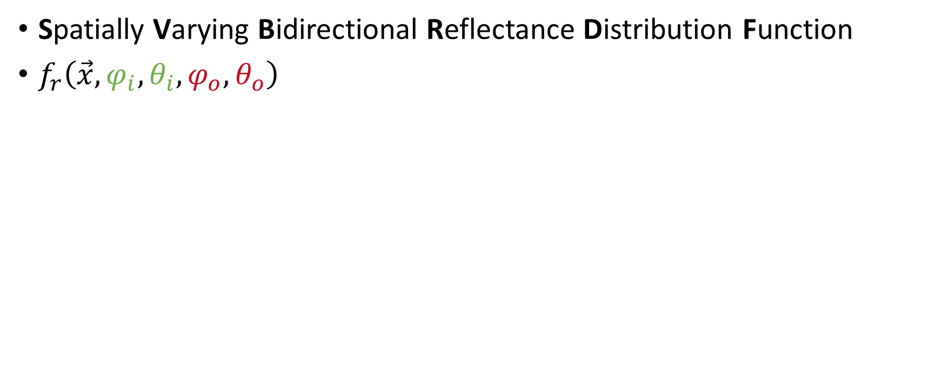
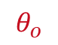
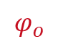

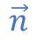
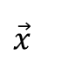
SVBRDF – Definition
Spatially Varying Bidirectional Reflectance Distribution Function
$f_{r}\left(\vec{x}, φ_{i},θ_{i},φ_{o},θ_{o}\right)$
$$θ_{o}$$
$$θ_{i}$$
$$\vec{n}$$
1
$$φ_{i}$$
$$φ_{o}$$
$$\vec{x}$$

